Slide 1
UNIT-1 THERMODYNAMICS OF AIR BREATHING PROPULSION SYSTEMS
By
A.VinothKumar
Assistant Professor
Department of Aerospace Engineering
SRM University

Slide 2
UNIT-1 SYLLABUS
Introduction
Thrust and efficiency
The ramjet
Turbojet engines
Turbofan engines
Turboprop and turbo-shaft engines
Typical engine performance
Engine-aircraft matching (introductory information)
Numerical problems.

Slide 3
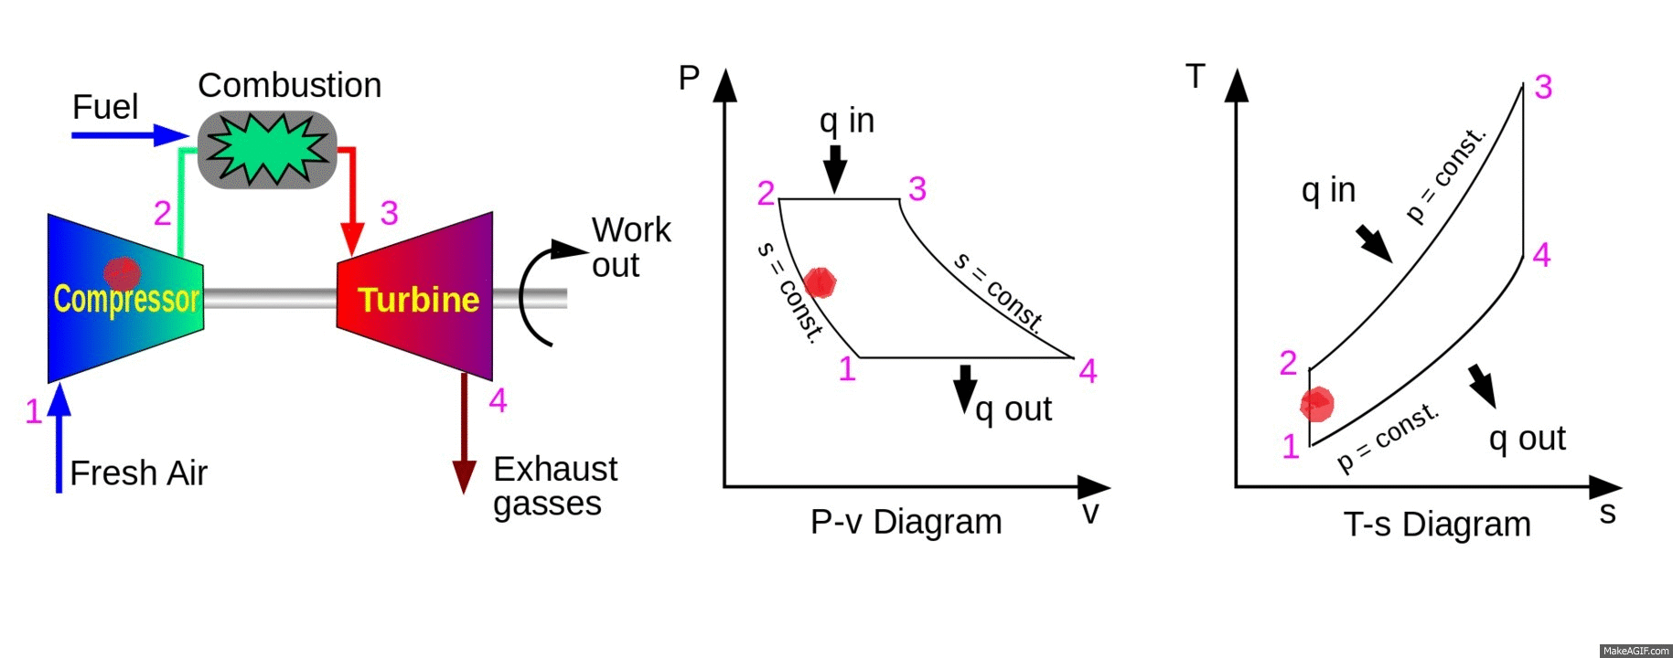
IDEAL BRAYTON CYCLE
The assumptions of ideal cycle is given as follows
Compression and expansion processes are reversible and adiabatic, i.e. isentropic.
The change of kinetic energy of the working fluid between inlet and outlet of each component is negligible.
There are no pressure losses in the inlet ducting, combustion chambers, heat-exchangers, intercoolers, exhaust ducting, and ducts connecting the components.
The working fluid has the same composition throughout the cycle and is a perfect gas with constant specific heats.
The mass flow of gas is constant throughout the cycle.

Slide 4
Where Q and W are the heat and work transfers per unit mass flow.
Applying this to each component, we get
For Compressor
For combustion chamber
For Turbine

Slide 5
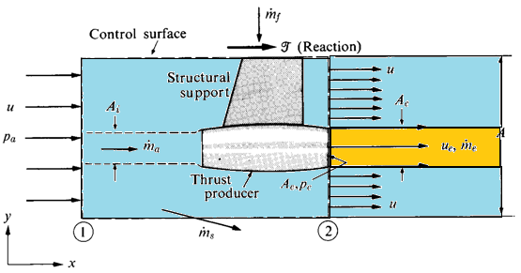
THRUST AND EFFICIENCY
( Since the flow is steady,
the control volume do not change with time )
( force and moment flux in the x-direction )

Slide 6
The momentum
Sub the above equation in momentum equation, we get

Slide 7
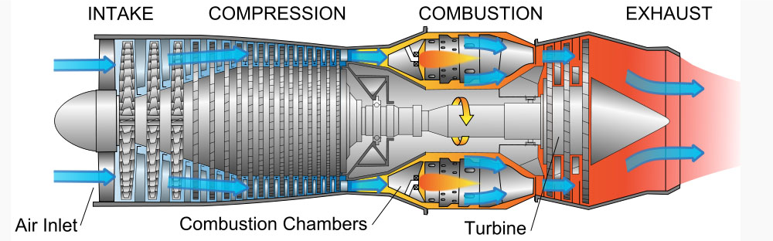
TURBOJET ENGINE
Turbojets are the oldest kind of general-purpose jet engines.
Turbojets are rotary engines that extracts energy from a flow of combustion gas.
They produce thrust by increasing the velocity of the air flowing through the engine and operate on Newton’s third law of motion " For every action there is an equal and opposite reaction”.

Slide 8
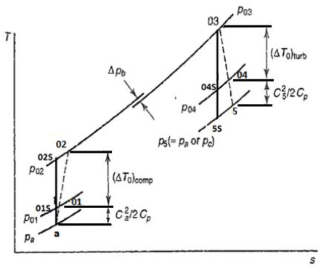
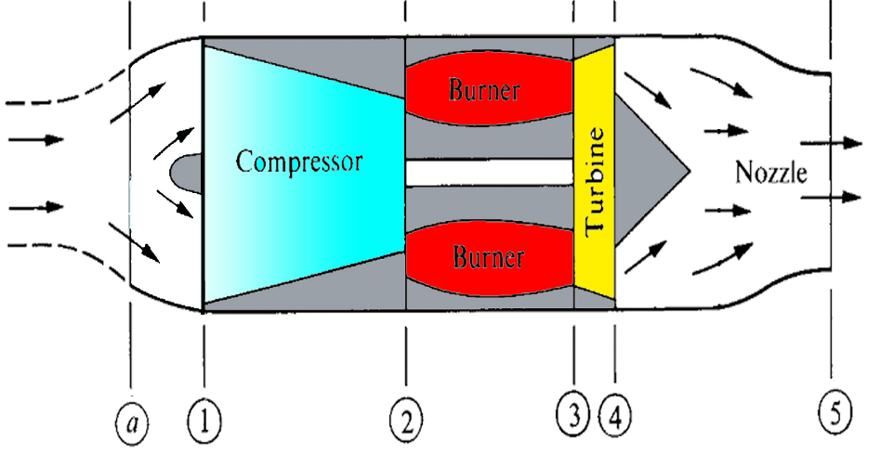
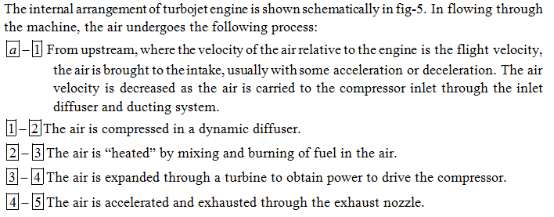
Turbojet without Afterburner

Slide 9
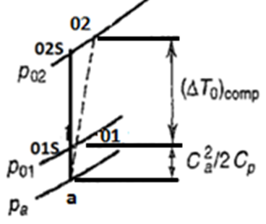

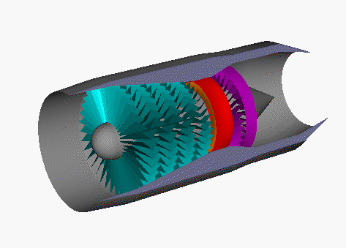

INTAKE
Air intake aims at bringing large amounts of surrounding air into the engine.
A tube-shaped inlet, like one you would see on an airliner usually of cylindrical or conical design.
Inlets come in many shapes and sizes depending on the aircraft.
Air intake

Slide 10
COMPRESSOR
The compressor rotates at very high speed, adding energy to the airflow and at the same time squeezing it into a smaller space. Compressing the air increases its pressure and temperature. The compressor is driven by the turbine.
Compressors used in turbojet engines are mainly classified as:
Axial Flow Compressors.
Centrifugal Compressors.

Slide 11
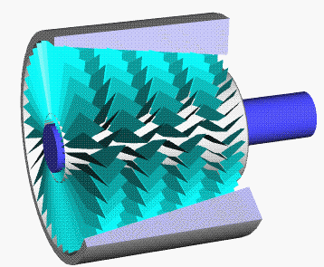
Axial Flow Compressor
Axial compressors are rotating, airfoil based compressors in which the working fluid principally flows parallel to the axis of rotation.
Axial compressors consist of a shaft that drives a central drum which has a number of annular airfoil rows attached. These rotate between a similar number of stationary airfoil rows attached to a stationary tubular casing.
A pair of rotating and stationary airfoils is called a stage.
The cross-sectional area between rotor drum and casing is reduced in the flow direction to maintain axial velocity as the fluid is compressed.

Slide 12
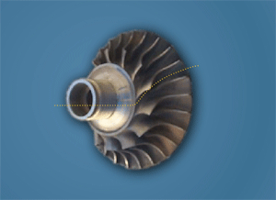

Centrifugal Compressor
Centrifugal compressors are rotating, airfoil based compressors in which the working fluid principally flows perpendicular to the axis of rotation.
Centrifugal compressors consist of a shaft that drives a impeller which has a number of curved blades.
The impeller rotates in a casing which is designed to convert the kinetic energy of the fluid into pressure energy before leaving the compressor.

Slide 13
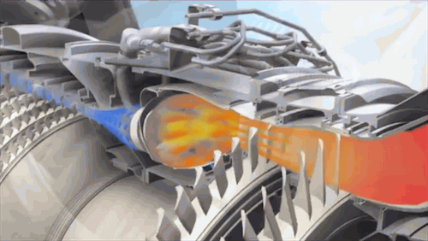
Combustion Chamber
In a turbojet the air and fuel mixture passes unconfined through the combustion chamber. As the mixture burns its temperature increases dramatically.
The combustion chamber is usually in the form of cans, which comprise the fuel injector and flame holder.

Slide 14
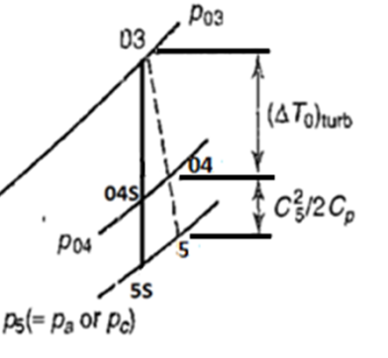
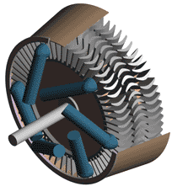
TURBINE
Hot gases leaving the combustor are allowed to expand through the turbine. Turbines are usually made up of high temperature metals such as inconel.
The turbine's rotational energy is used primarily to drive the compressor. and other accessories, like fuel, oil, and hydraulic pumps.
In a turbojet almost two-thirds of all the power generated by burning fuel is used by the compressor to compress the air for the engine.

Slide 15
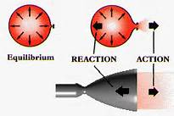
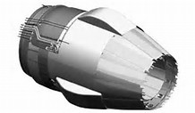
NOZZLE
After the turbine, the gases are allowed to expand through the exhaust nozzle to atmospheric pressure, producing a high velocity jet in the exhaust plume.
In a convergent nozzle, the ducting narrows progressively to a throat.

Slide 16
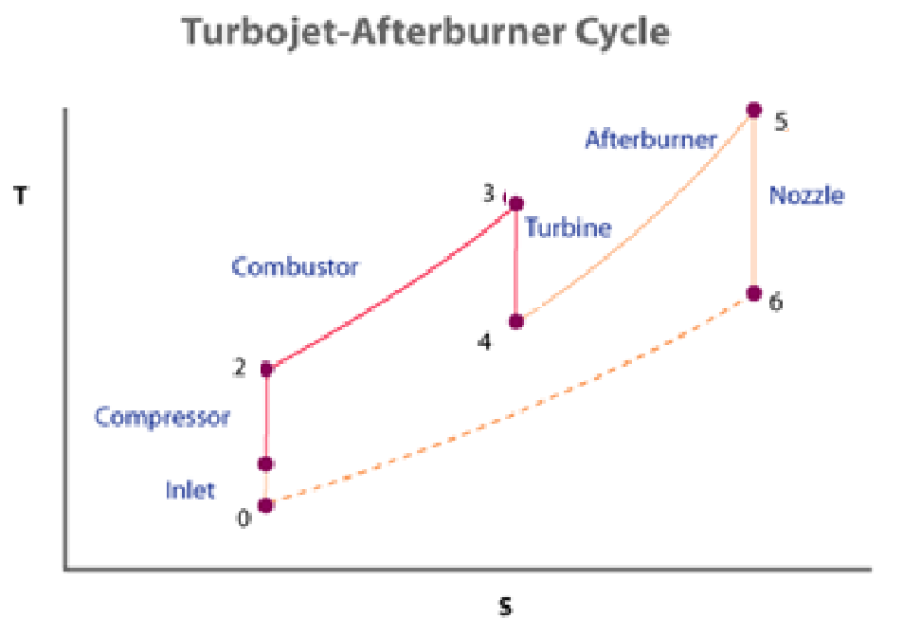
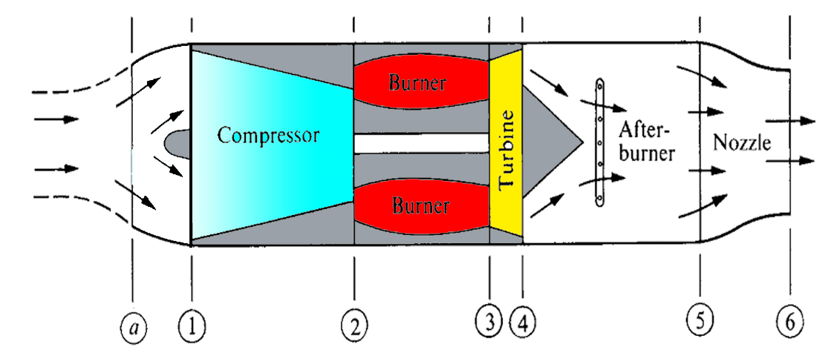
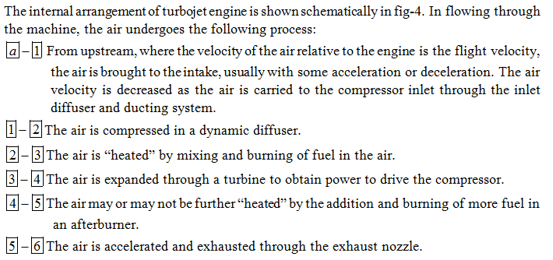
Turbojet Engine with Afterburner

Slide 17
TURBOJET ENGINE
Advantages
disadvantages
Very high power-to-weight ratio.
Compact than most reciprocating engines of the same power rating.
Fewer moving parts than reciprocating engines.
Low operating pressures.
High operation speeds.
Low lubricating oil cost and consumption.
Cost
Longer startup than reciprocating engines
Less responsive to changes in power demand compared to reciprocating engines.

Slide 18
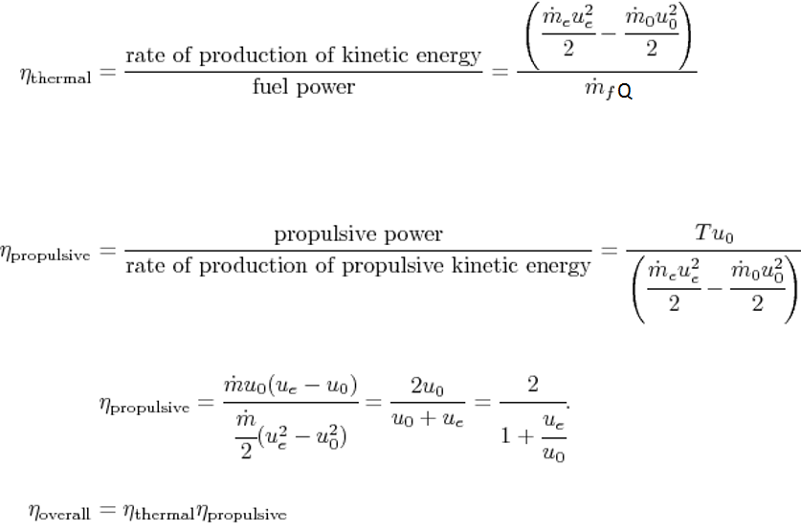
Engine efficiency

Slide 19
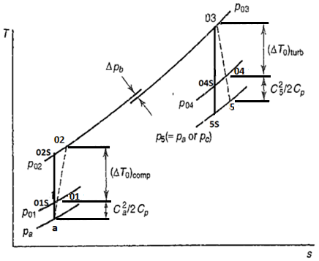
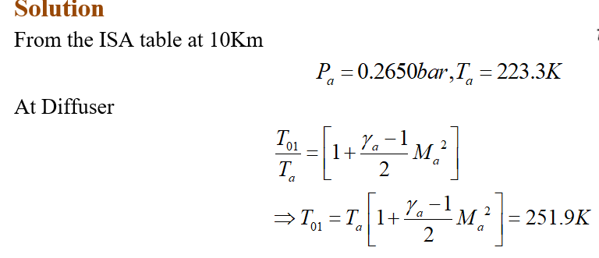
Determination of the specific thrust and SFC for a simple turbojet engine, having the following component performance at the design point at which the cruise speed and altitude are M=0.8 and 10,000m.
Compressor pressure ratio = 8.0
Turbine inlet temperature = 1200 K
Compressor efficiency, η_{c} = 0.87
Turbine efficiency, η_{t} = 0.90
Intake efficiency, η_{i} = 0.93
Nozzle efficiency, η_{N} = 0.95
Combustion efficiency, η_{b} = 0.98
Combustion pressure loss, ΔP_{b}= 4% compressor delivery pressure.
Mechanical transmission efficiency, η_{m}=0.99

Slide 20
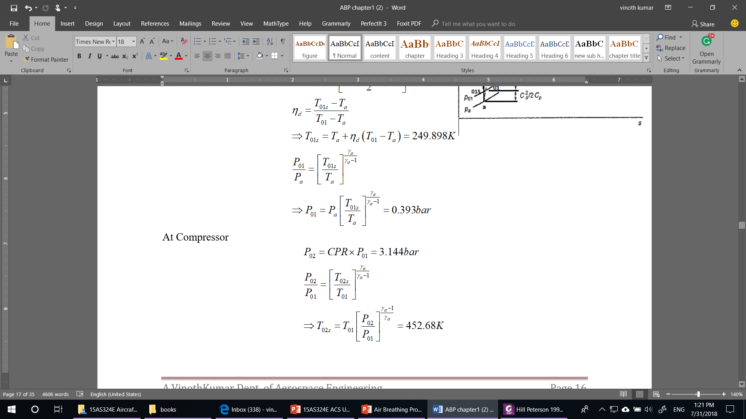
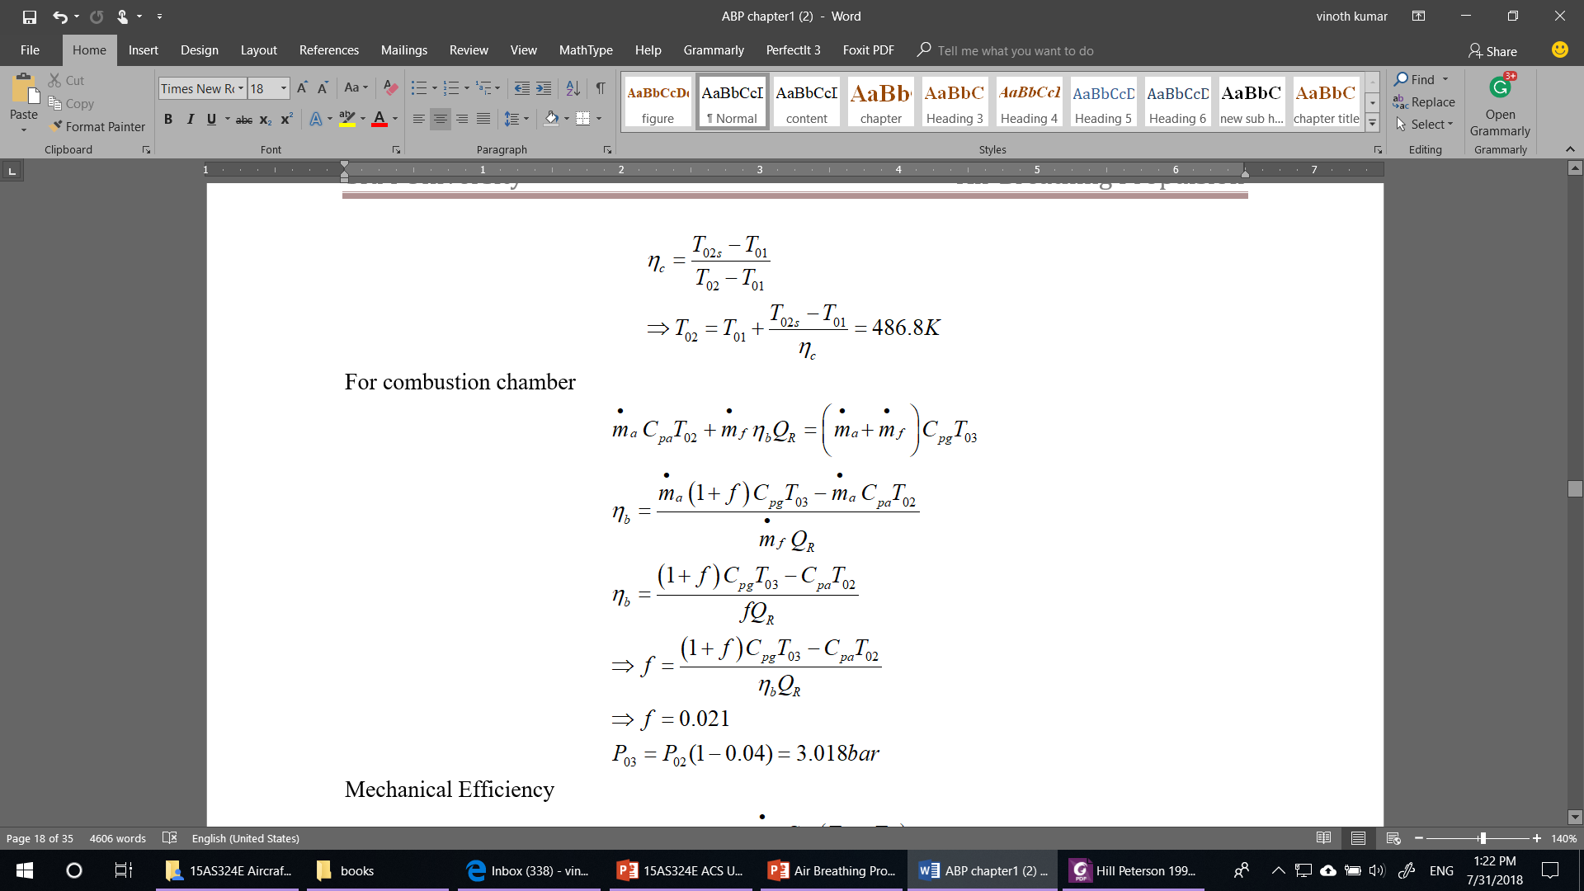

Slide 21
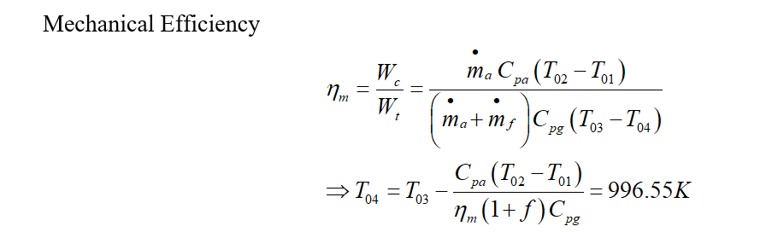

Slide 22
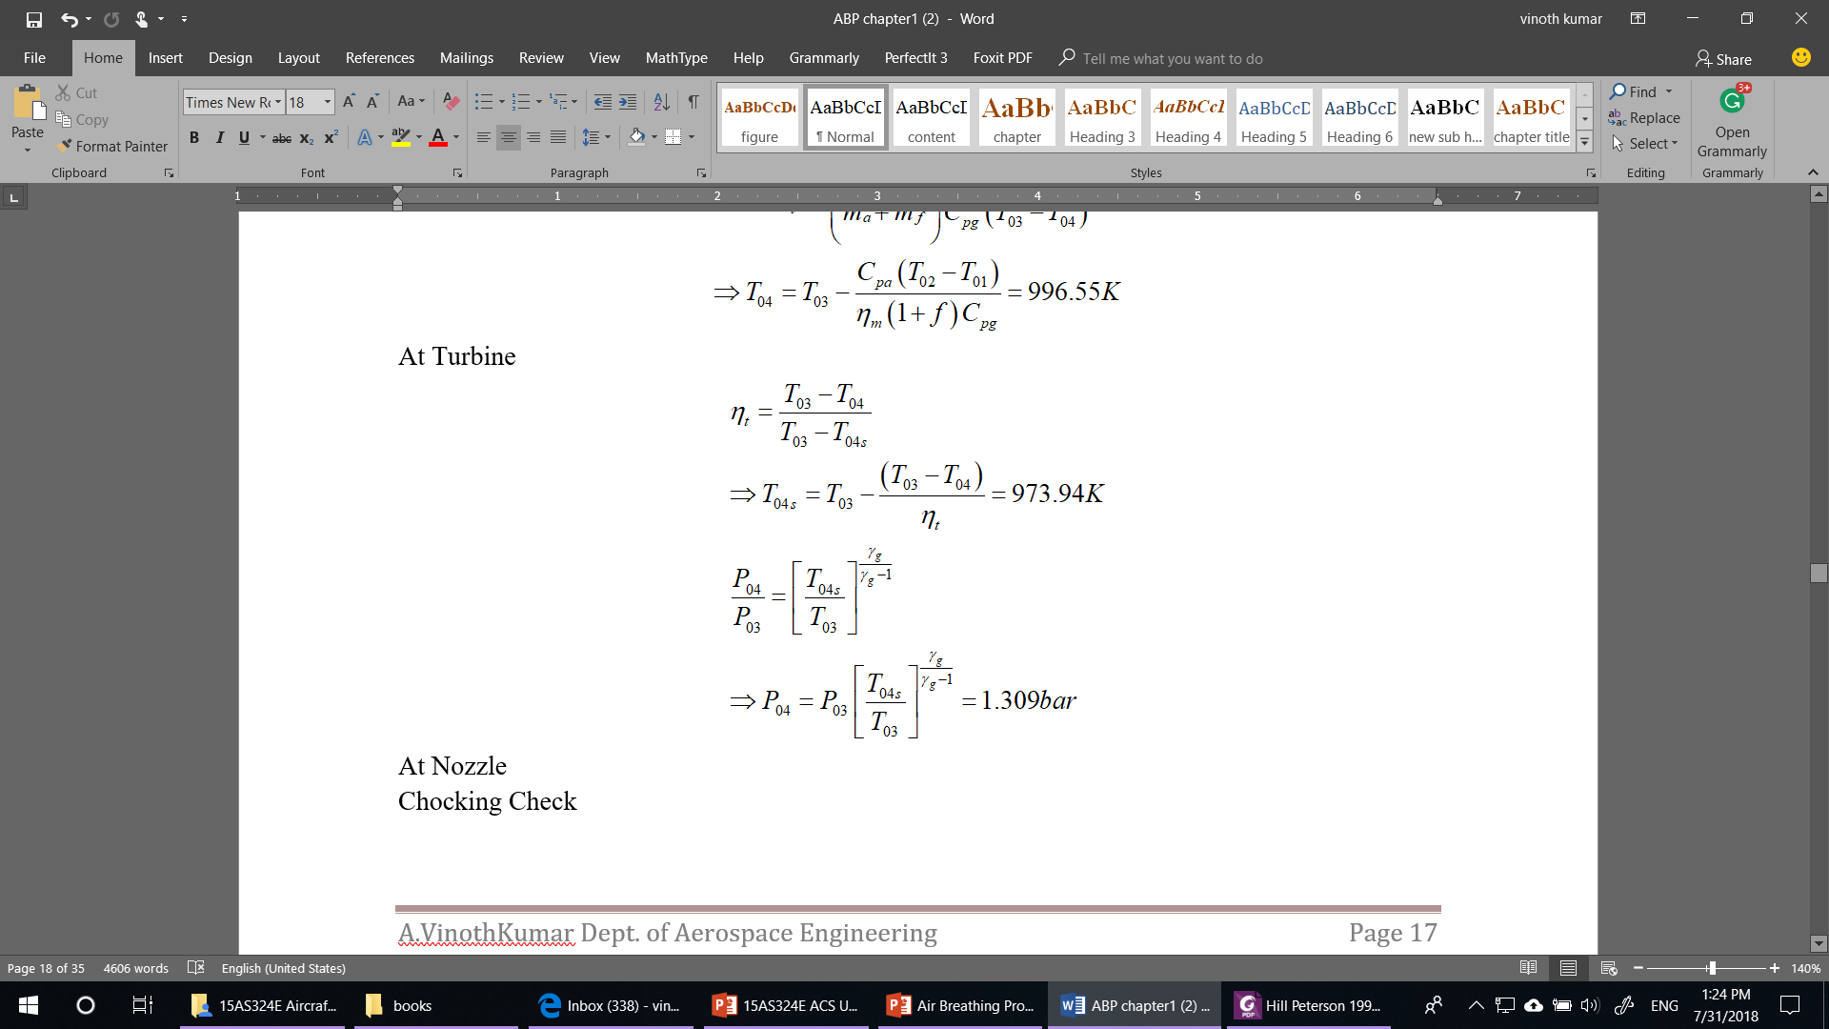
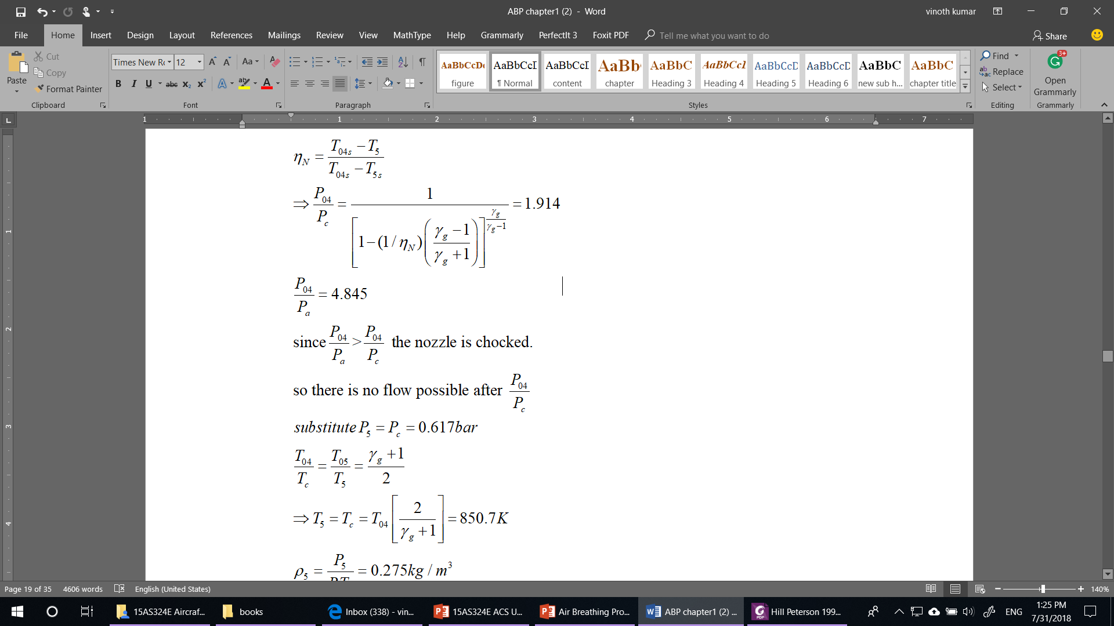

Slide 23
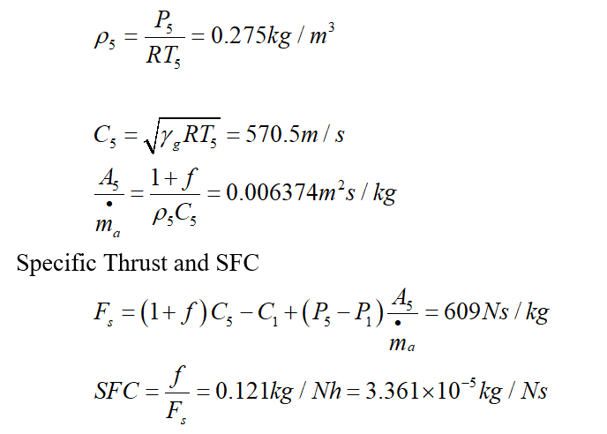

Slide 24
Turbofan Engine
For supersonic flight speeds, the overall efficiency of turbojets was outstanding. However, for high subsonic and transonic flight speeds (around 500-600 mph), the velocity of the exhaust gas jet was too high to obtain a good propulsive efficiency. Under these conditions, the bypass engine (also called turbofan ) became a very attractive approach for improving the propulsive efficiency.
In a turbofan engine, a fan of a diameter larger than the compressor is used to generate a mass flow higher than the core mass flow.

Slide 25
By pass ratio
Bypass ratio is defined as the ratio of the flow through the bypass duct (cold stream) to the flow at entry to the high-pressure compressor (hot stream), and it is given by
Turbofan engine
High-Bypass/unmixed Turbofan engine
Low-Bypass/mixed turbofan engine

Slide 26
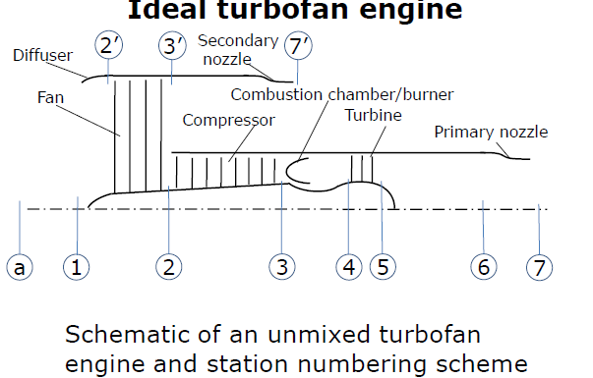
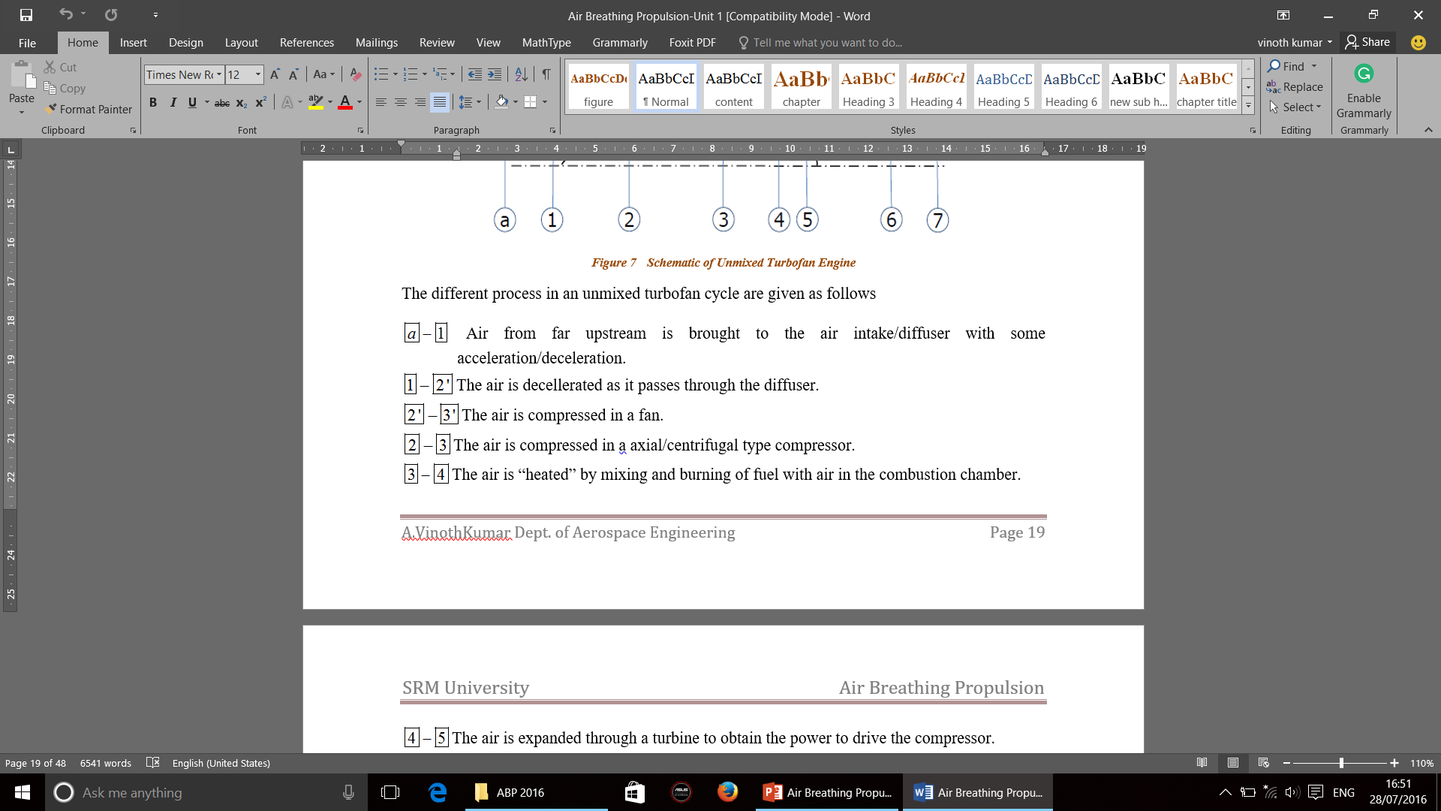
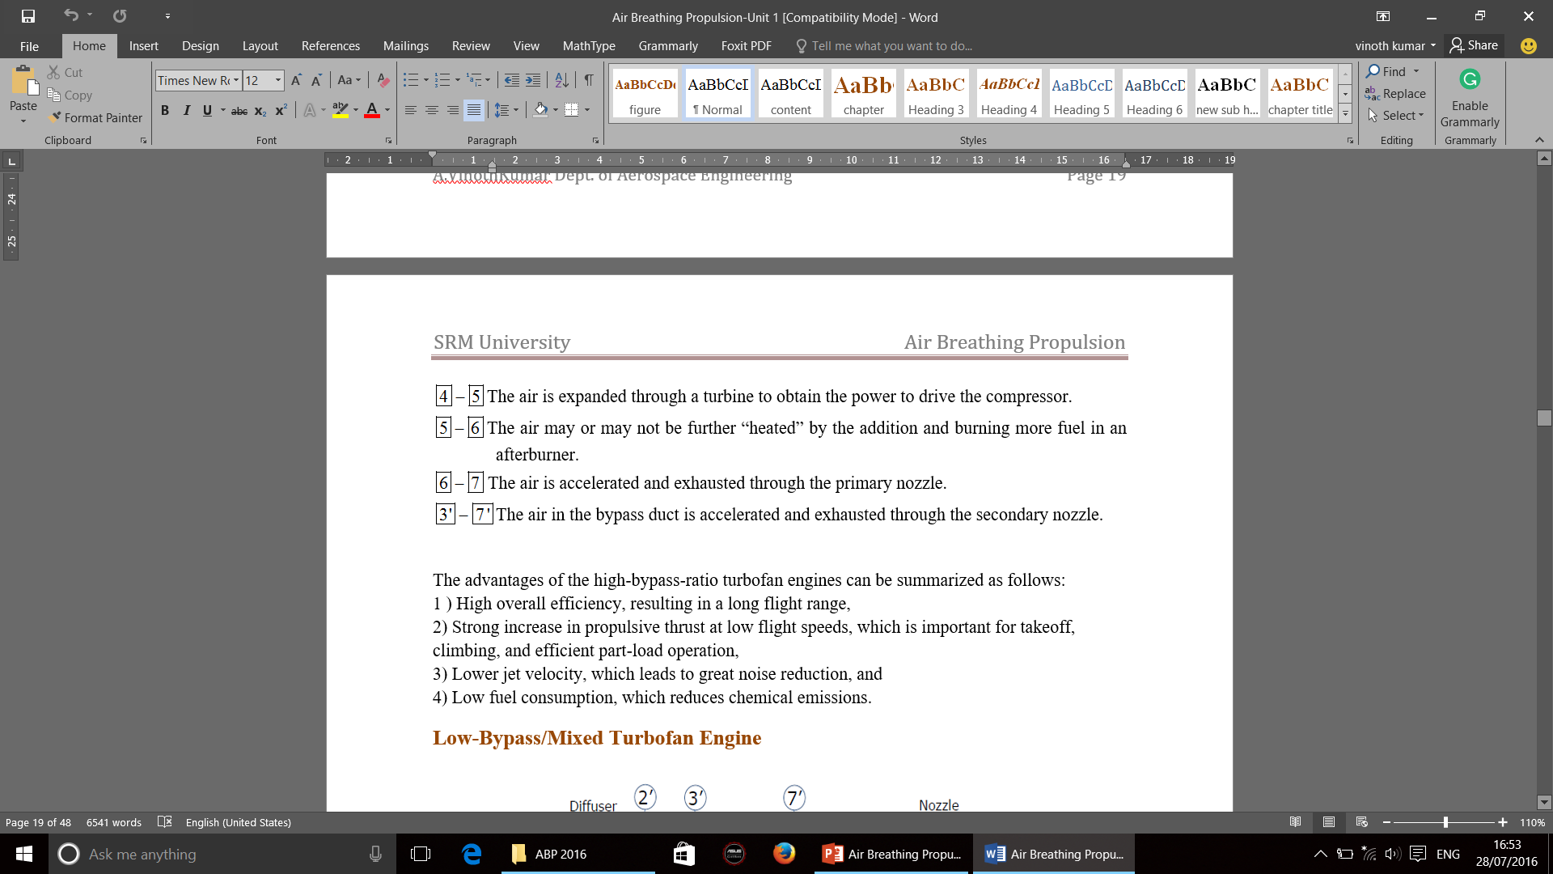
High-Bypass/Unmixed Turbofan Engine

Slide 27
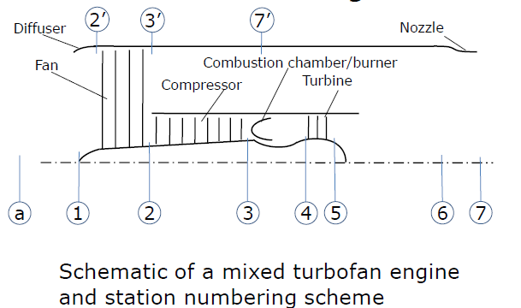
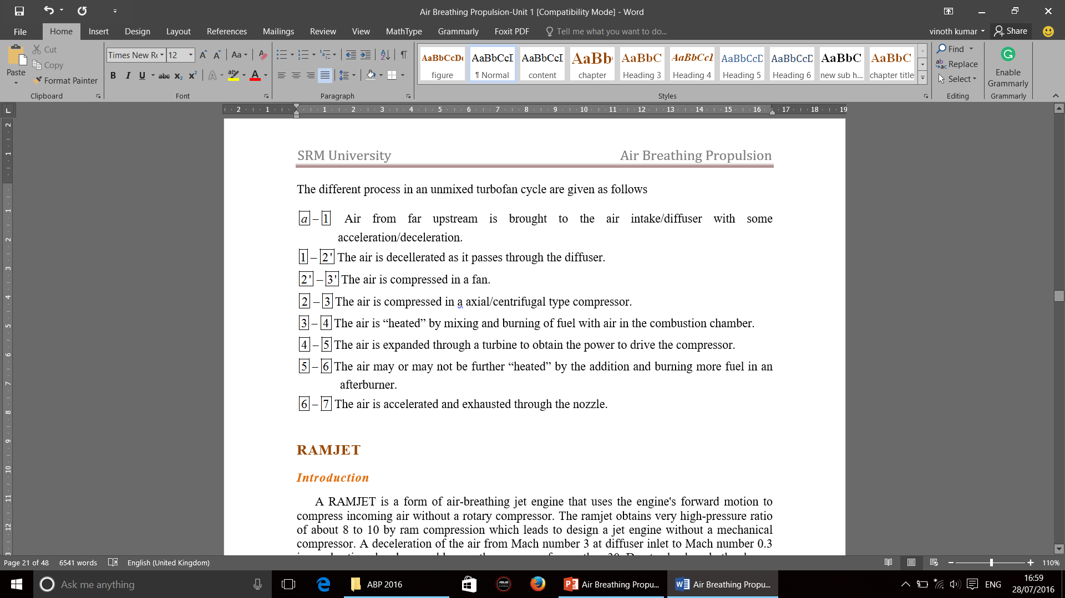
Low-Bypass/Mixed Turbofan Engine

Slide 28
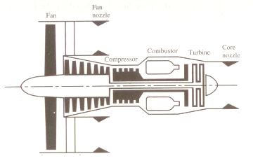
Ideal Turbofan Cycle
Inlet
3
6h
4
5
a
1
2
6c
Total thrust is generated by both cold and hot jets..

Slide 29
Thrust of Turbofan engine
Propulsive Power or Thrust Power:
Specific Thrust based on core flow S
Specific Thrust based on total flow S

Slide 30
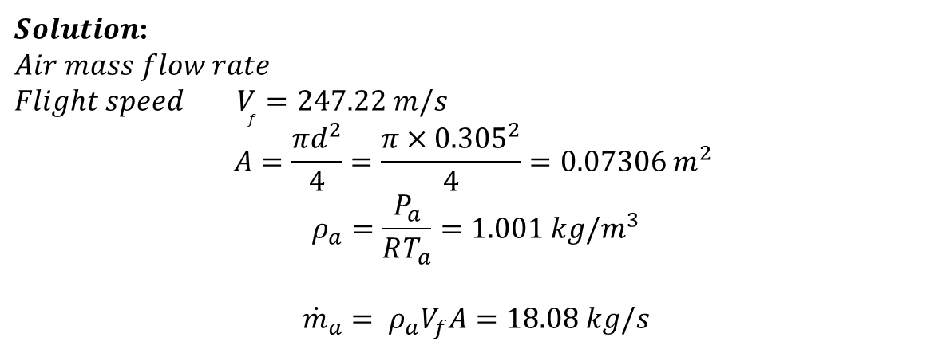
The Tomahawk is a long-range subsonic cruise missile powered by a small two-spool turbofan engine which has the following data:
Flight speed V_{f} = 247.22 m/s
Ambient temperature T_{a} = 275 K
Ambient pressure P_{a} = 0.79 bar
Thrust force F = 3.1 kN
Specific fuel consumption = 0.682 kg/kg-h
Bypass ratio = 1
Overall pressure ratio = 13.8
Fan pressure ratio = 2.1
Fan diameter= 0.305 m
Fuel heating value = 43,000 kJ/kg
Calculate air mass flow rate, fuel-to-air ratio, exhaust gas speed and engine maximum temperature.
$Solution$:
$$Air mass flow rate$$
$$Flight speed V_{f}=247.22 m/s$$
$$A=\frac{πd^{2}}{4}=\frac{π{×0.305}^{2}}{4}=0.07306 m^{2}$$
$$ρ_{a}=\frac{P_{a}}{RT_{a}}=1.001 kg/m^{3}$$
$${\dot{m}}_{a}= ρ_{a}V_{f}A=18.08 kg/s$$

Slide 31
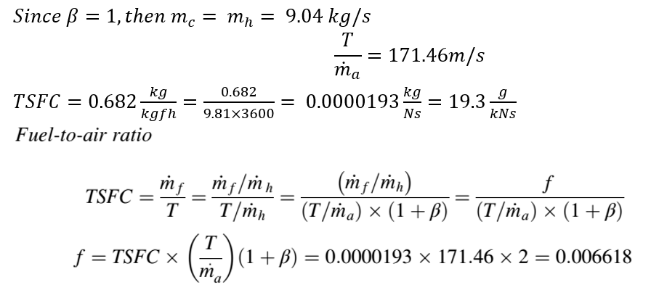
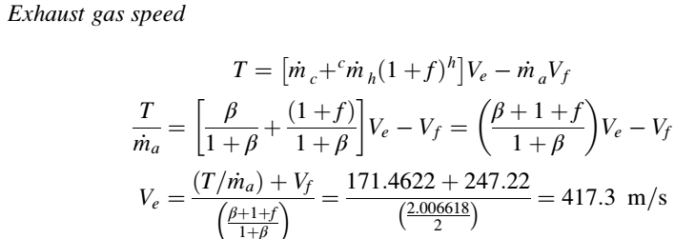

Slide 32
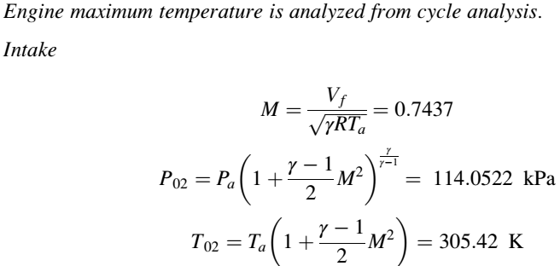
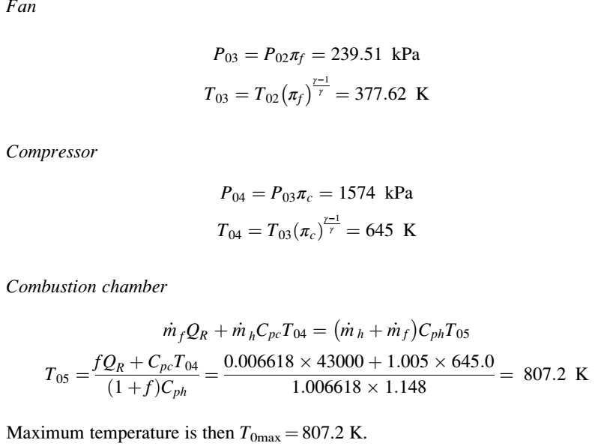

Slide 34
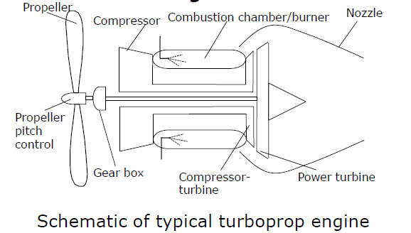
Turboprop & Turboshaft engine
Turboprop and turboshafts usually have a free turbine or power turbine to drive the propeller or the main rotor blade(turboshafts).
Stress limitation require that the large diameter propeller rotate at a lower rate and hence a speed reducer is required.
Turboprops may also have a thrust component due to the jet exhaust in addition to the propeller thrust. Thus in turboprops, thrust consists of the propeller thrust and the nozzle thrust.
The total thrust of a turboprop engine is equal to the sum of the nozzle thrust and the propeller thrust.

Slide 35
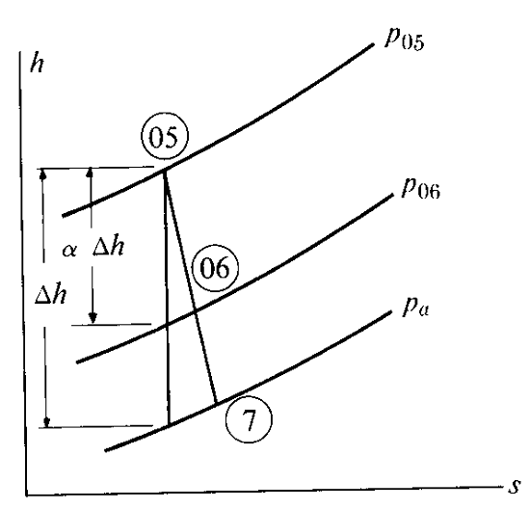
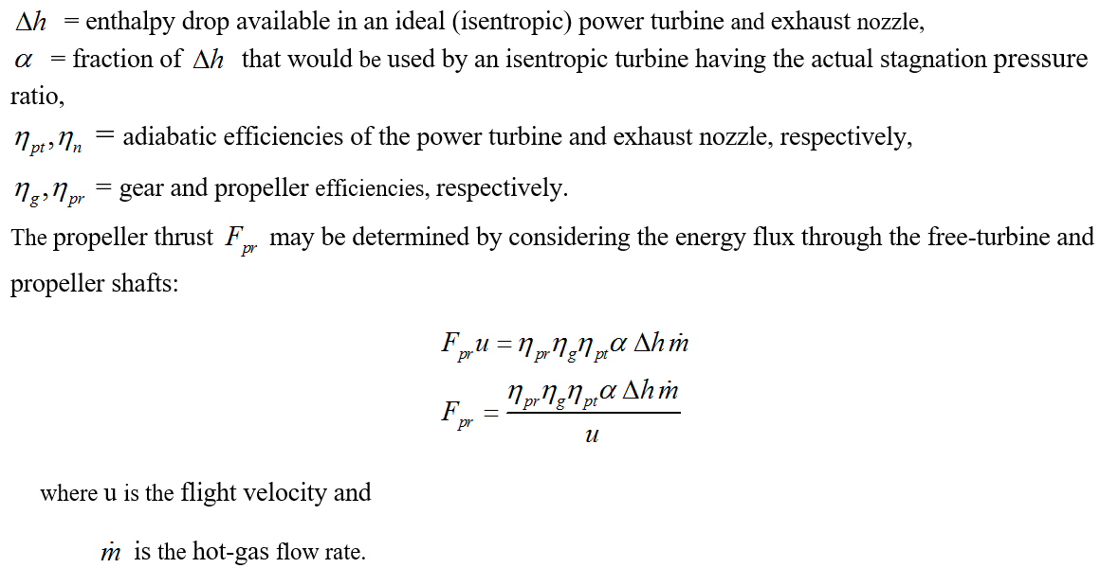

Slide 36
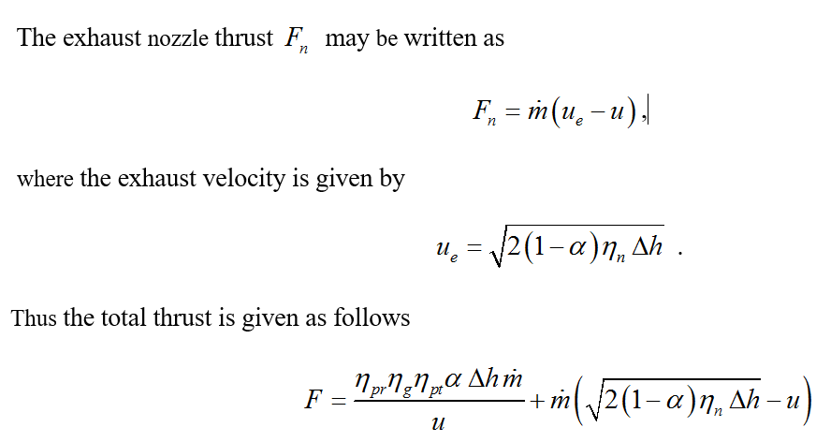

Slide 37
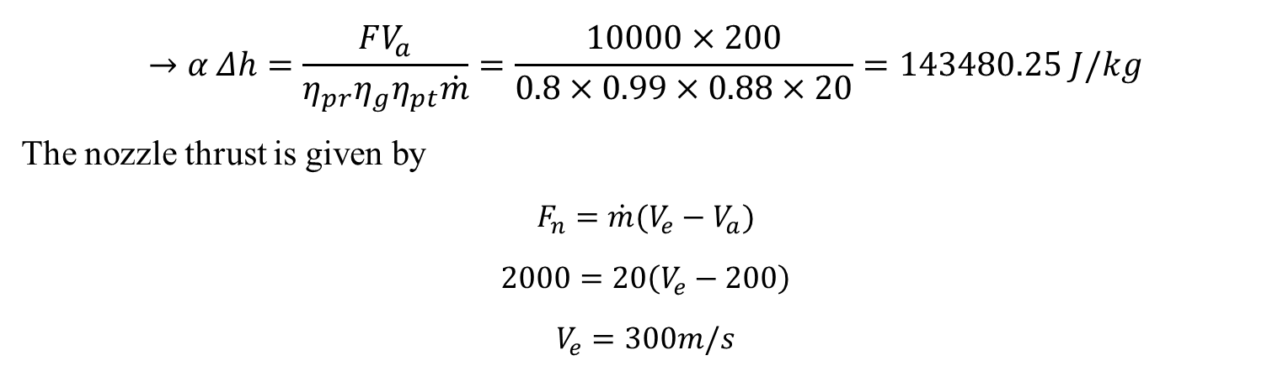
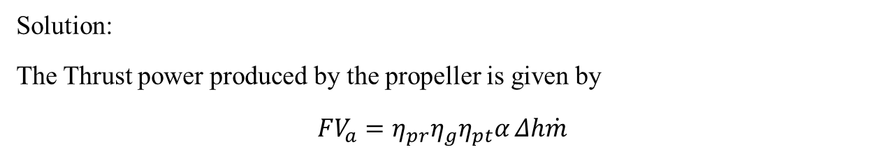
Consider an aircraft engine flying at 200m/s with the inlet mass flow rate of 20kg/s. the propeller of the engine is having an efficiency of 0.8, which produces the thrust of 10000N, while the jet produces the thrust of 2000N. The power turbine and nozzles have the efficiencies of 0.88 and 0.92. Calculate the jet Thrust produced by the engine if the power turbine and propeller is removed.
Solution:
The Thrust power produced by the propeller is given by
$$FV_{a}=η_{pr}η_{g}η_{pt}α Δh\dot{m}$$
$$→α Δh=\frac{FV_{a}}{η_{pr}η_{g}η_{pt}\dot{m}}=\frac{10000×200}{0.8×0.99×0.88×20}=143480.25 J/kg$$
The nozzle thrust is given by
$$F_{n}=\dot{m}(V_{e}−V_{a})$$
$$2000=20\left(V_{e}−200\right)$$
$$V_{e}=300m/s$$

Slide 38
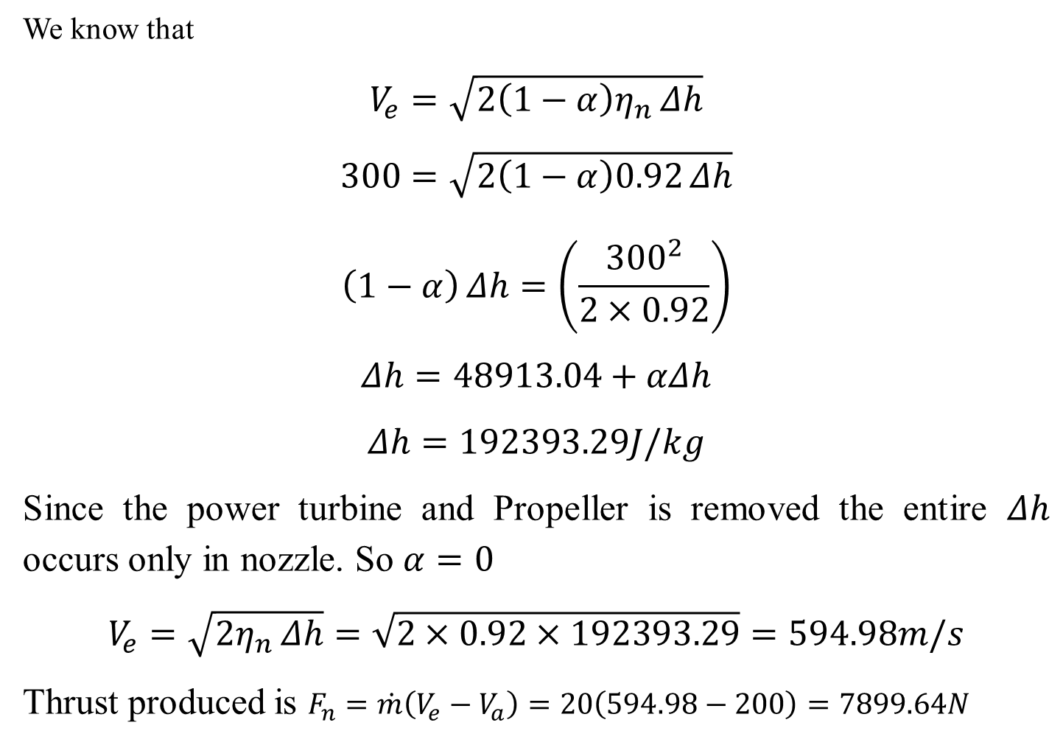
We know that
$$V_{e}=\sqrt{2\left(1−α\right)η_{n} Δh}$$
$$300=\sqrt{2\left(1−α\right)0.92 Δh}$$
$$\left(1−α\right) Δh=\left(\frac{{300}^{2}}{2×0.92}\right)$$
$$Δh=48913.04+αΔh$$
$$Δh=192393.29J/kg$$
Since the power turbine and Propeller is removed the entire $Δh$ occurs only in nozzle. So $α=0$
$$V_{e}=\sqrt{2η_{n} Δh}=\sqrt{2×0.92×192393.29}=594.98m/s$$
Thrust produced is $F_{n}=\dot{m}\left(V_{e}−V_{a}\right)=20\left(594.98−200\right)=7899.64N$

